Slide 1
Introduction To GitHub
June 01 2019 | SQL Saturday Dallas

Slide 2
About Me
Senior Database Administrator at Republic Bank
Friend of Red-Gate
Co-Chapter Leader of Louisville SQL Server and Power BI User Group.

Slide 3
Contact Info
Twitter : @CodeNameSQL
GitHub: jhiggin
Email: Joshua.Higginbotham@codenamesql.com

Slide 4

Speaker Feedback

Slide 5
Topics for today
Overview of Github
Setting up your remote environment
Working with git/github locally

Slide 6


Overview of GitHub

Slide 7

Facts about GitHub
Februay 2008
GitHub is Founded
4 June 2018
Purchased on June 4, 2018 by Microsoft for the small sum of $7.5 billion in stocks.
April 2005
Git is created by Linus Torvalds
Notes:
Git was created when the relationship between the company that made BitKeeper and the Linux communities relationship failed.

Slide 8
Octoverse Report - 2018
36M Registered Users
100M Repositories.
54% of the Fortune 50 use GitHub Enterprise
49% of the Fortune 100 use GitHub Enterprise
Notes:
Adoption of GitHub was early. Within the first year alone, 46,000 public repositories were created.

Slide 9
Source Control Types

Slide 10


Centralized version control
A single ”Source of Truth” copy of your project.
Some require a connection to the CVS system to be able to do things like committing changes or viewing history.
Suffers from the Mothership scenario from Independence Day.

Slide 11

Distributed Version control
Source control will still live in a central location, but each individual client will clone a full copy of the project to their local machine.
Protects you in the case of failure to the central server.
Client based clones can still access history and commit changes off network and push at a later time.

Slide 12
Setting Up Your Remote Environment

Slide 13
Feature Comparisons
There are currently 4 plans available for use with GitHub. The below link will provide a comparison between the different plans.
https://github.com/pricing#feature-comparison
Notes:
Free, Pro, Team, and Enterprise plans are available. Most day to day users will use the free plan which now allow unlimited private repositories as long as you remain under 3 contributors.

Slide 14
Setting up an Organization
Notes:
An organization is a way of grouping your repositories under one area. Prepares you for the "Getting hit by a bus" scenario.

Slide 15
Project Licensing
A License tells others what they are allowed to do with your source control and project. Due to this, it is important that you choose the right license for your project type. The below resources can be used to help you choose the best license for your project.
https://choosealicense.com
https://help.github.com/en/articles/licensing-a-repository
Notes:
Project licenses are a best practice standard. Without it, you allow people to do whatever they'd like with your code.

Slide 16
Initial Setup for Open Source Projects
Common practice dictates that your project should include the following items.
readme.md – Treated as a welcome page for your repo. Should give a broad overview of the project and instructions on how to interact with the repo and codebase.
contributing.md – Instructions on how to contribute to the project. Whether it’s opening an issue, testing a new feature, or developing new code. This should be the place to route people on how to do so.
Code_ofconduct.md – A code of conduct defines out what is expected of all contributors and visitors of the project. There are no exceptions to the policy and should be enforced to the T.

Slide 17
Securing Your Project
Creating protected branches ensures that contributors to your
source control project do not introduce detrimental changes to your code base.
By default, any changes that have no conflict between the head and base
branches can be merged. For additional info, please view the below resources.
https://help.github.com/en/articles/about-protected-branches
https://help.github.com/en/articles/about-code-owners

Slide 18
Securing Your Project (Continued)
GitHub currently tracks public vulnerabilities in Ruby gems, NPM, Python, Java, and .net packages.
By default, notifications are sent to project owners, but can
be configured to go to other parties.

Slide 19
Securing Your Project (Continued)
At times, there are certain files that you may not want included in your source control system. These files may contain items like sensitive credentials, server settings, or PII data.
By utilizing a file called .gitignore, we can decide which files and directories to ignore when we commit our code to source control. The .gitignore file should be included in your source code project, that way it is pulled by an contributors to your project.
Examples of .gitignore files can be located here: https://github.com/github/gitignore

Slide 20
Working with git/GitHub Locally

Slide 21
Setup and Initializing Commands
Fork – Making a copy of a repository. This is commonly used when making changes to another person or groups repository or using their project as a starting point or template.
Git Clone – Creates a local copy of a repository on your system and syncs between the local and remote locations.
Git Init– Initializes an existing directory as a Git Repository.

Slide 22
Staging and Snapshot Commands
Git Status – shows modified files in the current working directory.
Git Add – adds a file or all files in a directory to stage for the next commit.
Git Reset – unstages files while retaining the changes in the working directory.
Git Diff – displays changes that have been made.
Git Commit – Commits all stages changes as a new snapshot.

Slide 23
Branching and Merging Commands
Git Branch – lists all of your branches for the current repo.
Git Branch {Name} – Creates a new branch.
Git Checkout – switches to another branch and checks it out into your working directory.
Git Merge – merge the specified branch’s the history into the current branch.
Git Log - shows all commits in the current branch’s history.

Slide 24
Share and Update Commands
Git Remote Add – assigns a remote repo to a local repo.
Git Fetch – pulls down all branches from the remote location.
Git Push – Sends all local branch commits to the remote repository branch.
Git Pull – Fetch and Merge any commits from the tracking remote branch.

Slide 25
Working States / Areas
There are three states in which items can live locally in your Git Repo.
Modified / untracked changes
Staged
Committed
Notes:
1) Modified/Untracked and your Working Directory
Git views untracked and modified files similarly. Untracked means that the file is new to your Git project. Modified means that the file has been seen before, but has been changed, so is not ready to be snapshotted by Git. Modification of a file occurs in your working directory.
2) Staged and Staging Area
When a file becomes staged, it's taken into the staging area. This is where Git is able to take a snapshot of it and store its current state to your local repository. This area is also known as the Index.
3) Committed and the Git Directory
Committed means that Git has officially taken a snapshot of the files in the staging area, and stored a unique index in the Git directory. The terms snapshotted and committed are very similar. The significance of being committed is that you can now revert back to this project's current state at any time in the future.

Slide 26
Branching
A branch is a means to isolate development work from existing branches within your repository. Each repository has a default branch that acts as your primary source location for code and history.
The best way of to visualize branching is with a tree. Your primary branch is your trunk and your code branches are the individual branches of the tree that all converge into the trunk.

Slide 27
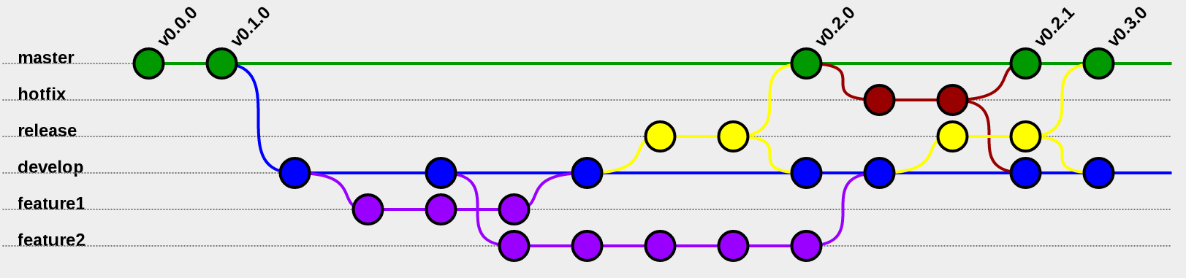
Branching (Continued)
This Photo by Unknown Author is licensed under CC BY-SA
https://www.atlassian.com/git/tutorials/comparing-workflows/gitflow-workflow
Notes:
Visual representation of the Git Flow process.

Slide 28
Additional Resources
Learn GitHub Branching: https://learngitbranching.js.org/
GitHub tutorials: https://lab.github.com/
GitHub cheat sheet: https://github.github.com/training-kit/downloads/github-git-cheat-sheet.pdf

